Slide 1

Corporate Finance Group Project
Group Members: Hassan Fayyaz, Jules Day, Sandy Chen, Luis De Leon, Mimi Fang, Laura De Los Santos

Slide 2
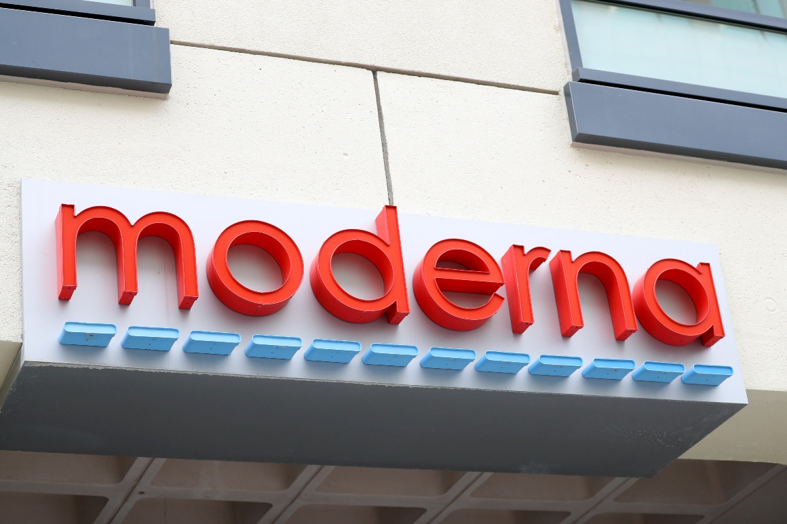


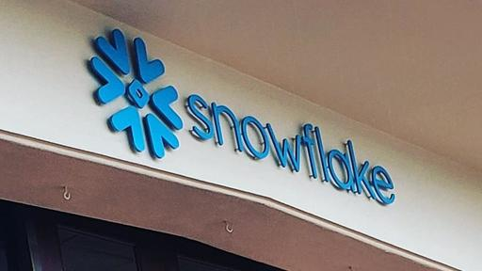
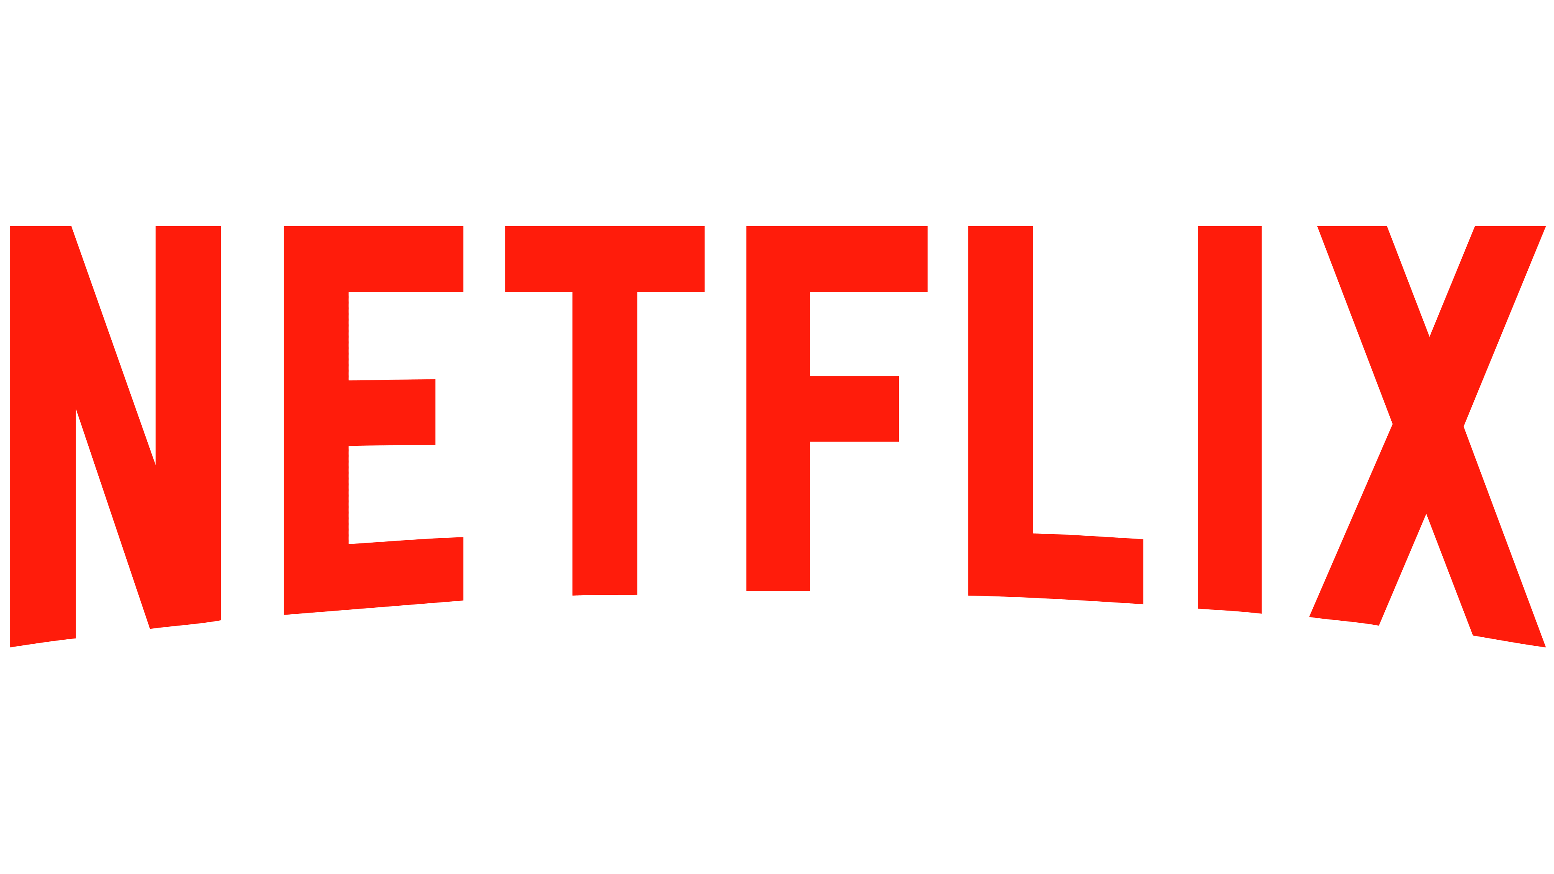

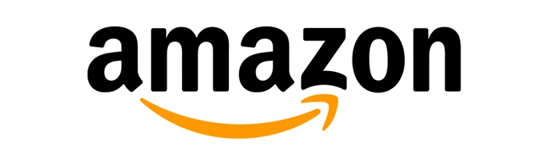


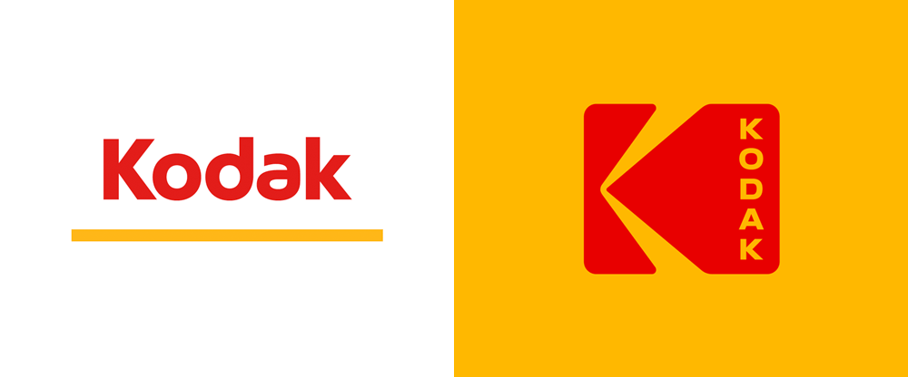
Stocks
DraftKings
Snowflake
Moderna
Tesla
Netflix
Zoom
Amazon
eBay
Microsoft
Kodak

Slide 3
Executive Summary
The Nasdaq finished the lowest with a decrease in growth by 0.19 percent.
The S&P 500 had a growth of 2.53 percent.
The Dow Jones had an increase in growth by 3.57 percent.
DraftKings finished with a growth of 22.48 percent.
Snowflake it is currently up to 2.36 percent.
Moderna it is currently up to 38.51 percent.
Tesla it has grown 14.61
Netflix has fallen by 10.73 percent since August 26,.
Zoom has grown by 47.3 percent since August 26th,
Amazon fell by 9.76 percent
eBay fell by 15.49 percent.
Microsoft fell by 4.36 percent
Kodak currently sits at 13.34 percent growth

Slide 4
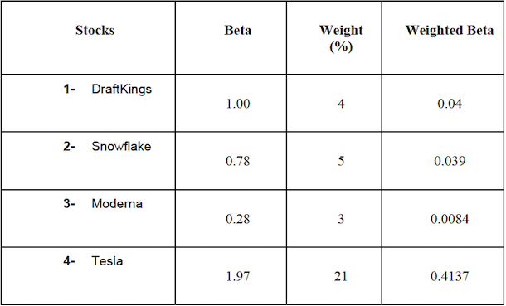
Risk Profile of the Portfolio

Slide 5
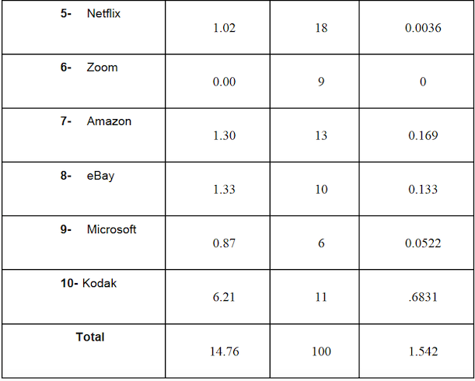
Risk Profile of the Portfolio (continue)
Notes:
Portfolio's Overall Beta: 1.542
Beta average of the 10 stocks: 1.48
Explanation: Our portfolio has a relatively high systematic risk as the portfolio's overall beta is approximately equal to 1.542, which is highly bigger than 1. Kodak was the riskiest with a beta score of 6.2, and Zoom has the lowest risk with a beta of 0.

Slide 6
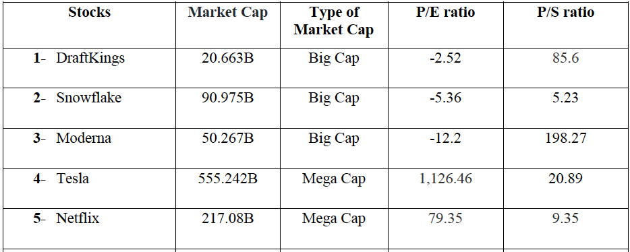
Types of Stocks Selected

Slide 7
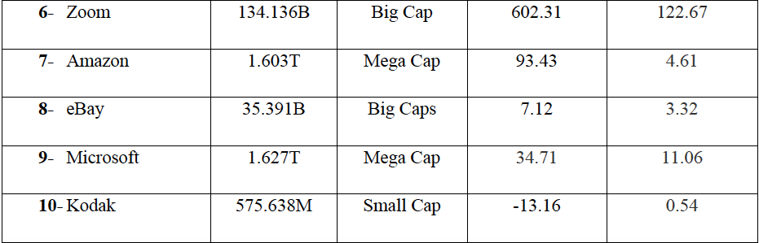
Types of Stocks Selected (continue)
Notes:
Types of Caps:
Mega Caps: A mega cap stock has a market cap of $200 billion and greater.
Big/large Caps: A big cap stock has a market cap of $10 billion and greater.
Mid-Caps: A mid cap stock has a market cap between $2 to $10 billion.
Small Caps: A small cap has a market cap between $300 million to $2 billion.

Slide 8
Types of market caps in our portfolio
Our portfolio stocks consist of large-cap, mega-cap, and small-cap stocks.
DraftKings, Snowflake, Moderna, Zoom, and eBay stocks are all large stocks as their market cap is greater than or equal to $10 billion.
Whereas Tesla, Netflix, Amazon, and Microsoft stocks have a mega-market cap.
Kodak is the only stock in our portfolio with a small market cap.

Slide 9
Types of stocks based on the ratios
The price-to-earnings ratio (P/E ratio):
Tesla and Zoom have a high P/E ratio.
DraftKings, Snowflake, Moderna, and Kodak has a negative P/E ratio.
The price-to-sales (P/S) ratio:
Moderna and Zoom have the highest P/S ratios
The past 6 to 12-month return
Zoom, Amazon, Tesla, and Microsoft are currently hot stocks in the market.

Slide 10
Reasons why we chose these stocks
DraftKings: DraftKings, being a sports betting operator, was chosen right before the football season began. After Covid-19 suspended all sports, we witnessed people's passion and need for sport, so we knew DraftKings would perform well. This also corresponded with the time of the NBA and MLB Season.
Snowflake: We chose Snowflake due to the articles given in class. We learned that there have been many investors putting money into tech companies, and Snowflake was one that was highlighted.

Slide 11
Reasons why we chose these stocks (continue)
Moderna: Moderna is one of the companies looking into a COVID-19 vaccine. Moderna was getting really good results and was seeing a steady rise in investors and return given people’s faith in the company. It’s interesting to see companies like this especially during the pandemic because their success will determine whether we as a people continue to quarantine and social distance or not. Moderna (as of 11/20/20) currently has a stock price of $97.61, which is a 500% rise from the beginning of this year. As of right now, Moderna is in phase 3, which is when the vaccine is ready to go through human trials. They have shown that their vaccine has an efficacy rate of 94.5%, which is extremely promising.

Slide 12
Reasons why we chose these stocks (continue)
Tesla: Over time, we saw an incredible rise in both popularity and stock return in Tesla. As we observe our surroundings, we hear about Tesla’s amazing new electric cars with dog mode or about their advances in sustainable living. The more we heard about Elon Musk and his rise in popularity, the more interested we became in the company (and especially David Dobrik’s Tesla giveaways). It was only when we looked into the company that their popularity wasn’t the only thing to rise. It was amazing to see that at the beginning of this year Tesla’s stocks were only worth $86. Now it's worth $489.61 (as of 11/20/20). That’s a 569% rise in price.

Slide 13
Reasons why we chose these stocks (continue)
Netflix: We chose Netflix because it is the number one TV show streaming provider with nearly 190 million subscribers, and its stock price represents that accurately. It is modern-day cable TV. Many people are ditching regular cable providers for Netflix and that trend is continuing. Since 2010, cable TV is dropping in viewers by nearly 4% and that trend is continuing while Netflix is rising. Due to the pandemic, Netflix is rising even more because everyone is stuck at home and they want a cheap form of entertainment.

Slide 14
Reasons why we chose these stocks (continue)
Zoom: We chose Zoom because of its popularity increase. Due to social distancing, Zoom is used for everything right now (job interviews/meetings, school lectures etc.) to replace face-to-face interactions. The price of Zoom had nearly quadrupled during the pandemic. Even though there is a small decrease, it seems to be keeping its momentum. Many noticed it is a good way to have virtual meetings.

Slide 15
Reasons why we chose these stocks (continue)
Amazon and eBay: The pandemic caused by the coronavirus has taken a big turn with the Amazon company and eBay. The reason why we decided to buy Amazon and eBay shares was that Amazon and eBay have been able to respond perfectly to consumer demand, being the leader in online commerce, and it seems that it will be this way for some time since new measures taken to control the pandemic include a preference for the online over the physical. People can buy without leaving the house and even useful resources such as laptops to work from home or for online classes at good prices or second hand.

Slide 16
Reasons why we chose these stocks (continue)
Microsoft: Microsoft is a stock that has consistently gone up and profited since it became public in March 1986. I believe this trend will continue during Covid-19 and will continue to rise after Covid-19. As the world becomes more modernized, computers will be more and more in demand. The core of a computer is the operating system, and Microsoft owns the operating system, i.e. Windows 10. Therefore, Microsoft will always earn a profit from it. That is why we believe this stock is a good choice for us.

Slide 17
Reasons why we chose these stocks (continue)
Kodak: Kodak is a stock that we believe we should be shorting. Its stock has been at an all-time low for the spike to $60 in July. It is because of the news that President Trump is giving them an excessive amount of money to convert from a camera company to a pharmaceutical company. This news occurred near the peak of COVID 19 when vaccines became a need. Ever since the company stock price has been dropping, and there has been no news of any drugs that have and will be released.

Slide 18
Top 5 Stocks & their Key Variables

Slide 19
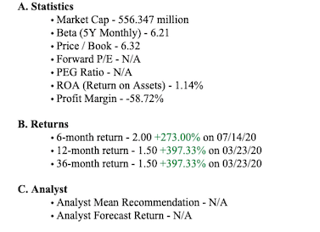
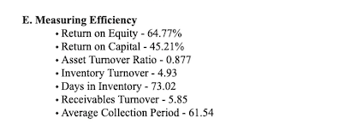
Kodak

Slide 20
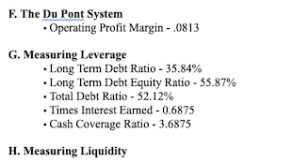
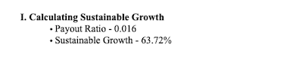
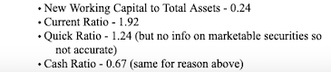
Kodak (continue)

Slide 21
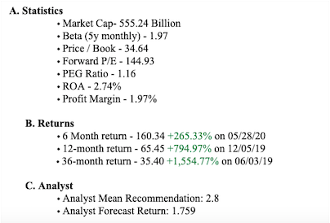
Tesla

Slide 22
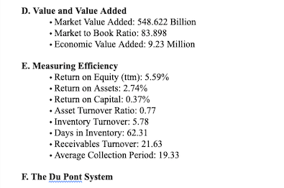
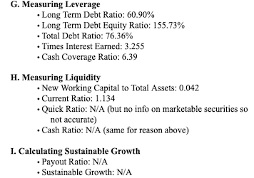
Tesla (continue)

Slide 23
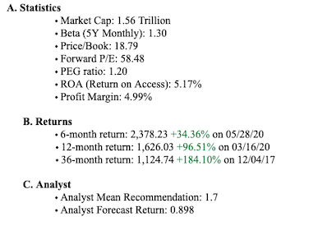
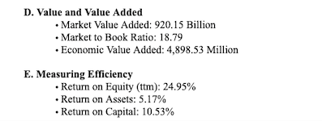
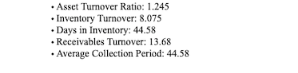
Amazon

Slide 24
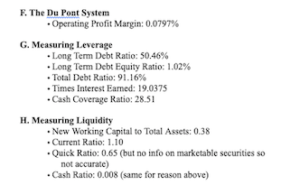
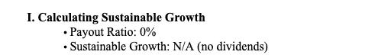
Amazon (continue)

Slide 25
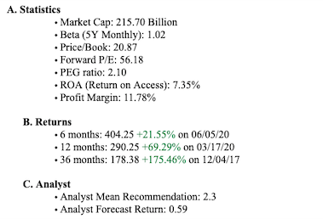
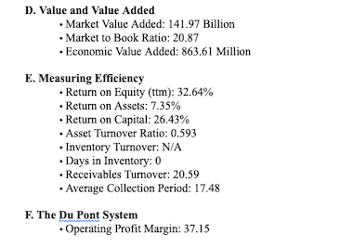
Netflix

Slide 26
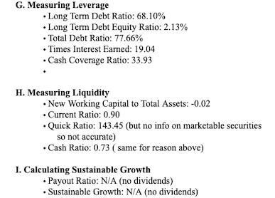
Netflix (continue)

Slide 27
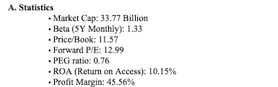
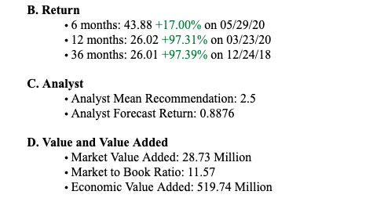
eBay

Slide 28
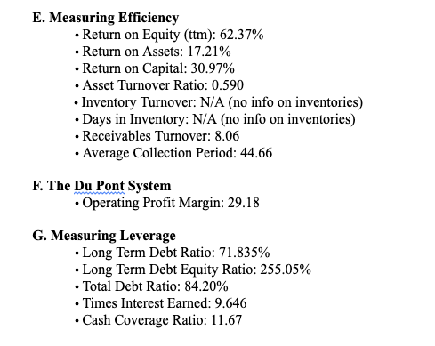
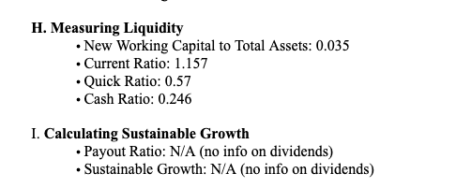
eBay (continue)

Slide 29
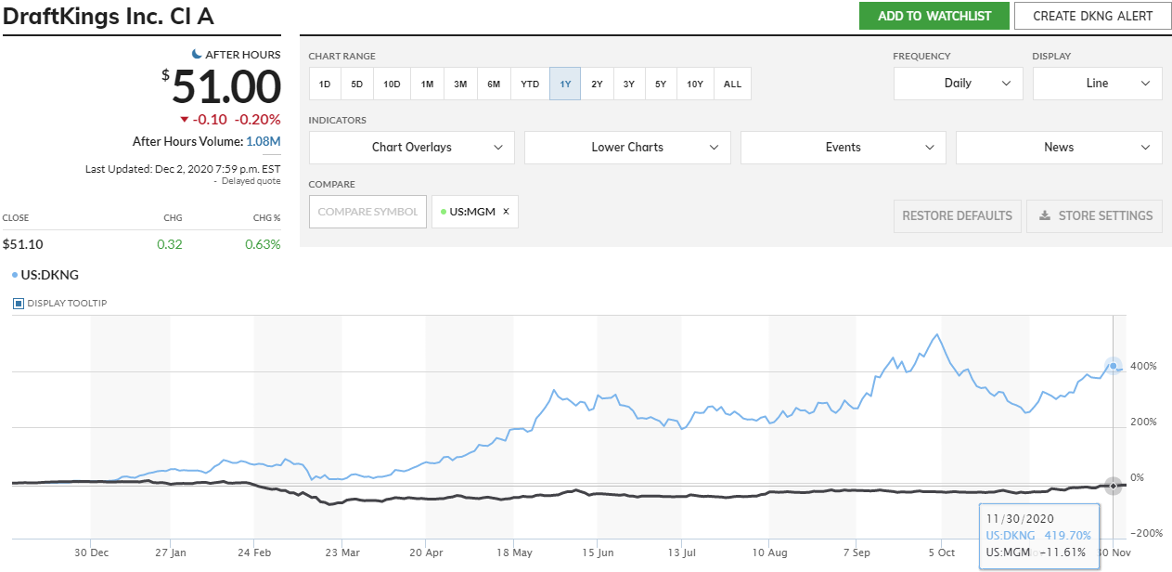
DraftKings vs MGM Resorts International
Both companies are known for sports betting. While DraftKings is an industry-leading daily fantasy sports and mobile sports betting platform, MGM is the world's largest hotel and casino. They both generate revenue from other people gambling. Due to the pandemic, hotels and casinos are empty so more people are using DraftKings even though MGM has its own online sports betting. Being the industry leader, DraftKings is currently thriving through this pandemic.

Slide 30
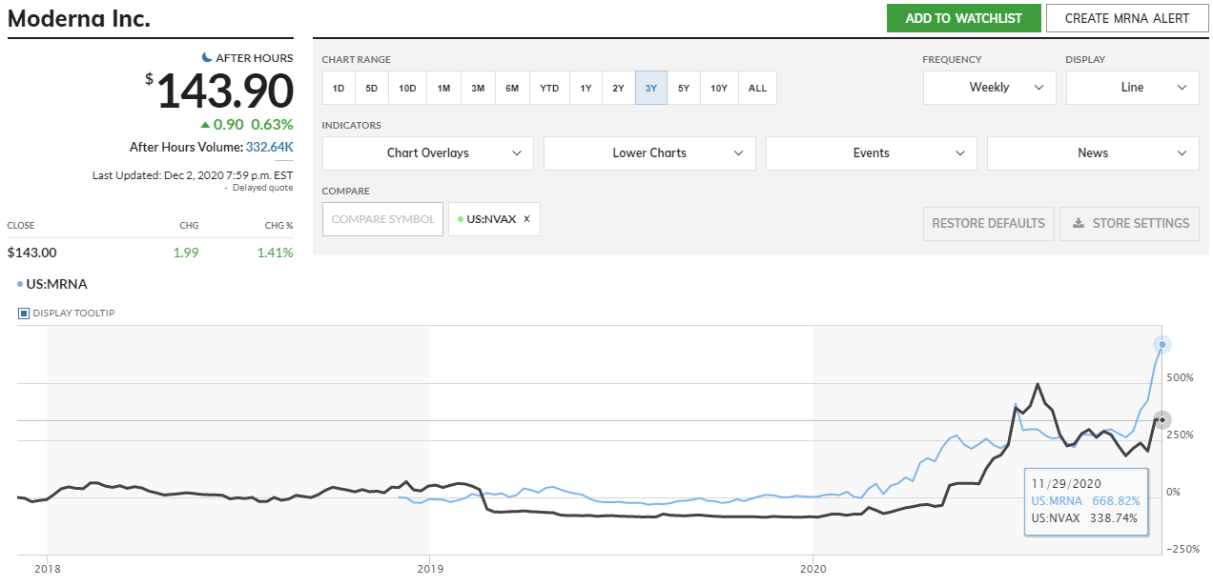
Snowflake vs Salesforce
Salesforce is a similar company to Snowflake because they are both cloud-based software companies and among the few cloud-based software companies out there.
*There is limited data on Snowflake since it went public only three months

Slide 31
Moderna vs Novavax
With the current coronavirus pandemic, every pharmaceutical company is working on a vaccine. These two companies do not compare well with standard industry averages because most of the pharmaceutical companies already have previous drugs released while these two don’t have much in the past but are the two leading developers for the Covid-19 vaccine. Depending on whichever company introduces an FDA approved Covid-19 vaccine, its stock will skyrocket.

Slide 32
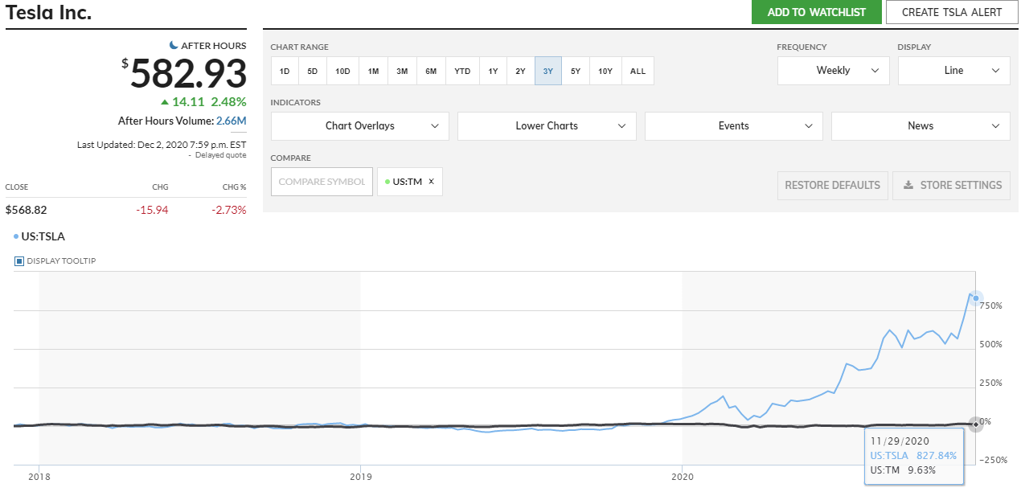
Tesla vs Toyota
We compared Tesla with Toyota because Toyota was once the most valuable car company. Tesla has since replaced it. There are other electric car companies, most notably NIO but given how new the company is, it would be an off-the-scale comparison to Tesla. Tesla stock has blown up in the most recent months and continues to rise. With Tesla’s continuous growth, it has the potential of becoming a league of its own like Amazon.

Slide 33
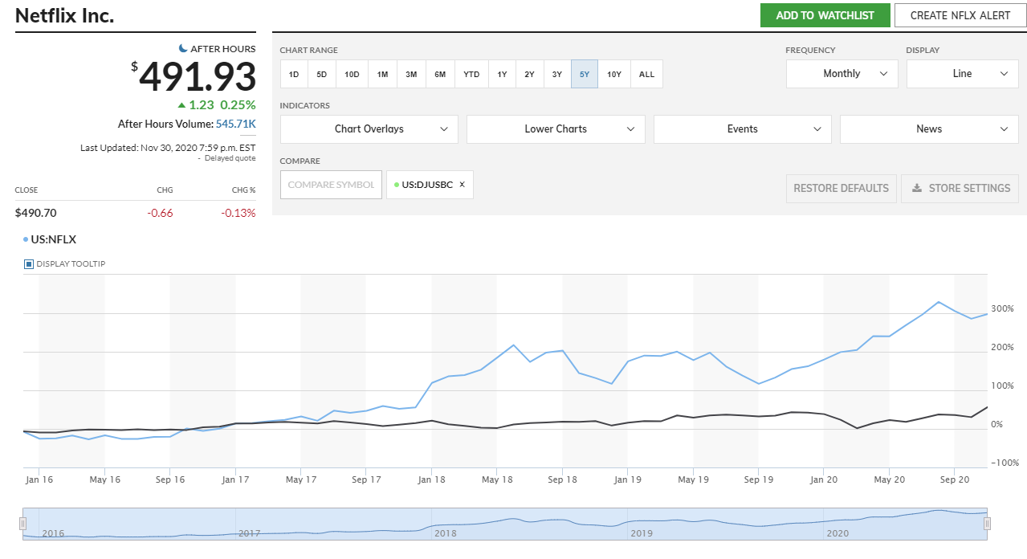
Netflix vs Industry Averages
Netflix’s competitors include Amazon Prime Video and Hulu but since Prime Video is not Amazon’s only source of profit and Hulu is owned by Disney, they are not good comparisons.
So, we will compare Netflix to the industry averages. As shown in the chart over a 5-year period, the blue line (Netflix) is significantly higher than the black line (Industry Averages). Also, with more people staying at home, Netflix is one of the more popular choices for entertainment.

Slide 34
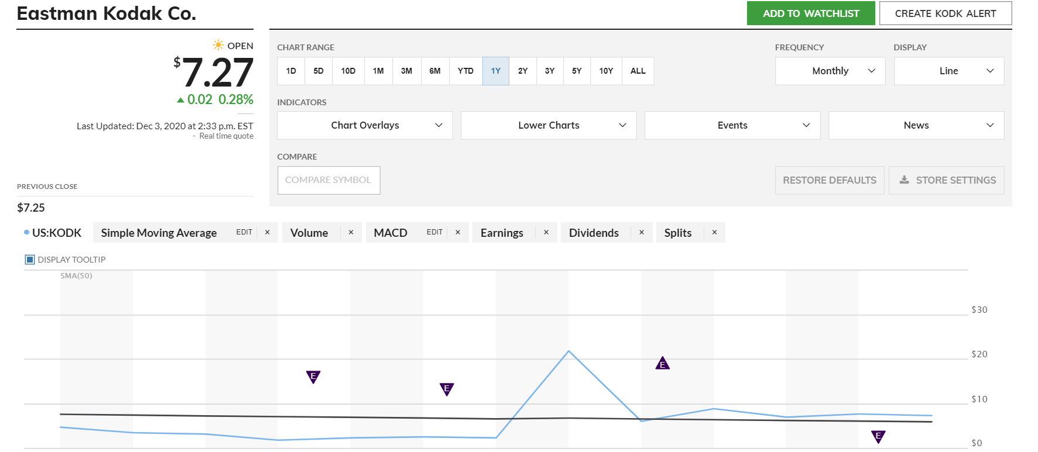
Kodak vs Industry Averages
At the beginning of the year Kodak(blue line) struggled in comparison to the industry average(black line). They even had an opening stock price under $2 but it has improved and had an explosive June reaching a high opening price of $60. Now they are having, on average, a slightly higher stock price then their competitors

Slide 35
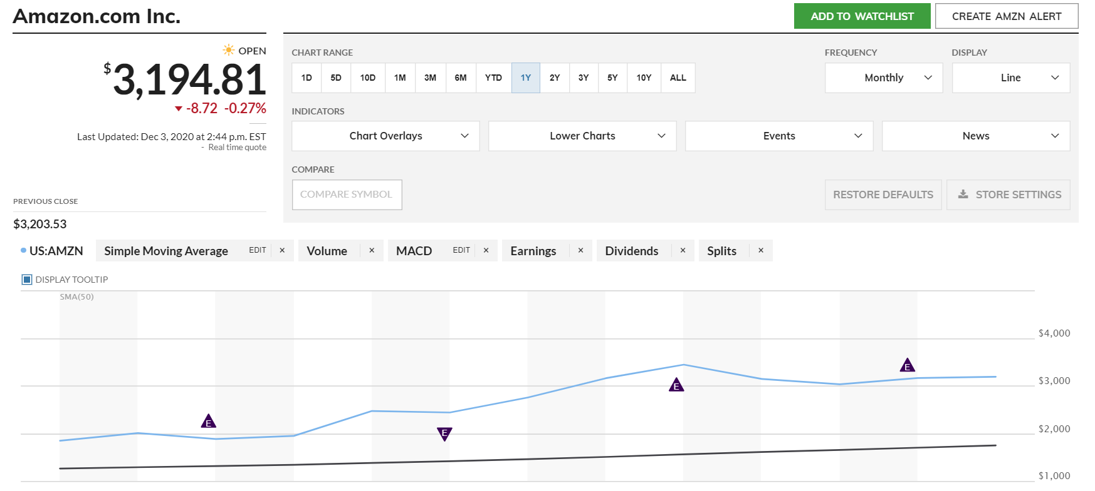
Amazon vs Industry Averages
Amazon is in a league of its own; it doesn't really have competitors. It has to be compared to massive retail chains such as Walmart but as you can see from the stock prices Amazon's stock has been valued massively more than the industry average and has been increasing steadily throughout the year.

Slide 36
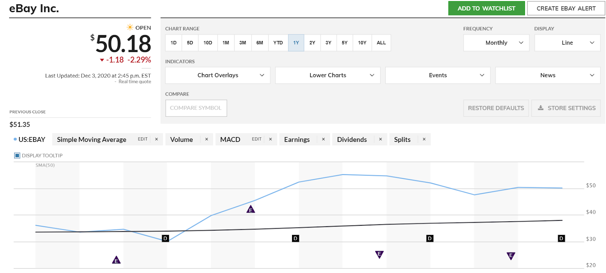
eBay vs Industry Averages
eBay did suffer during the pandemic in March, even dropping below the industry average but since has recovered and increased its value. Probably due to the fact that stores are closing, or people are afraid to go to stores now.

Slide 37
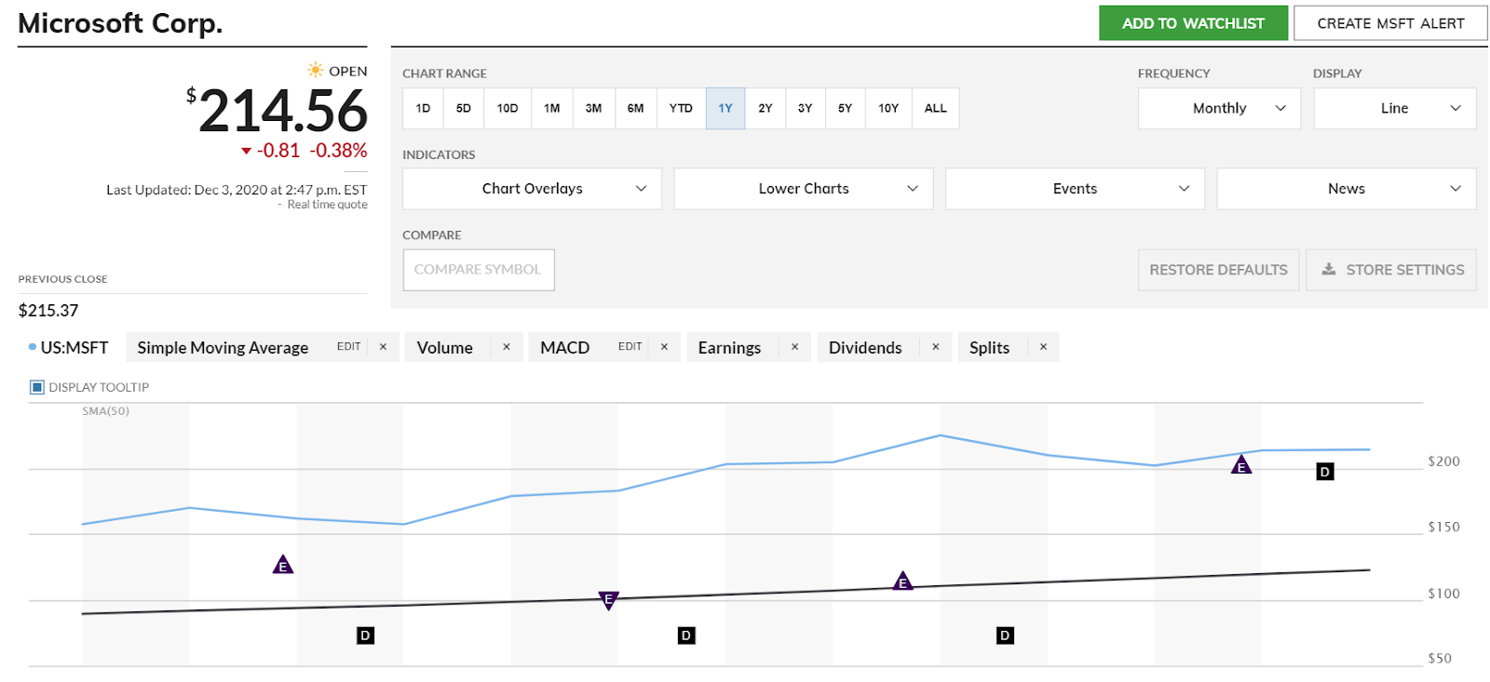
Microsoft vs Industry Averages
Like most companies the pandemic had a negative effect on Microsoft's stock price, which led to the year's lowest opening and closing prices. But with it being Microsoft it bounced back quickly and still stand above the rest of the competition.

Slide 38
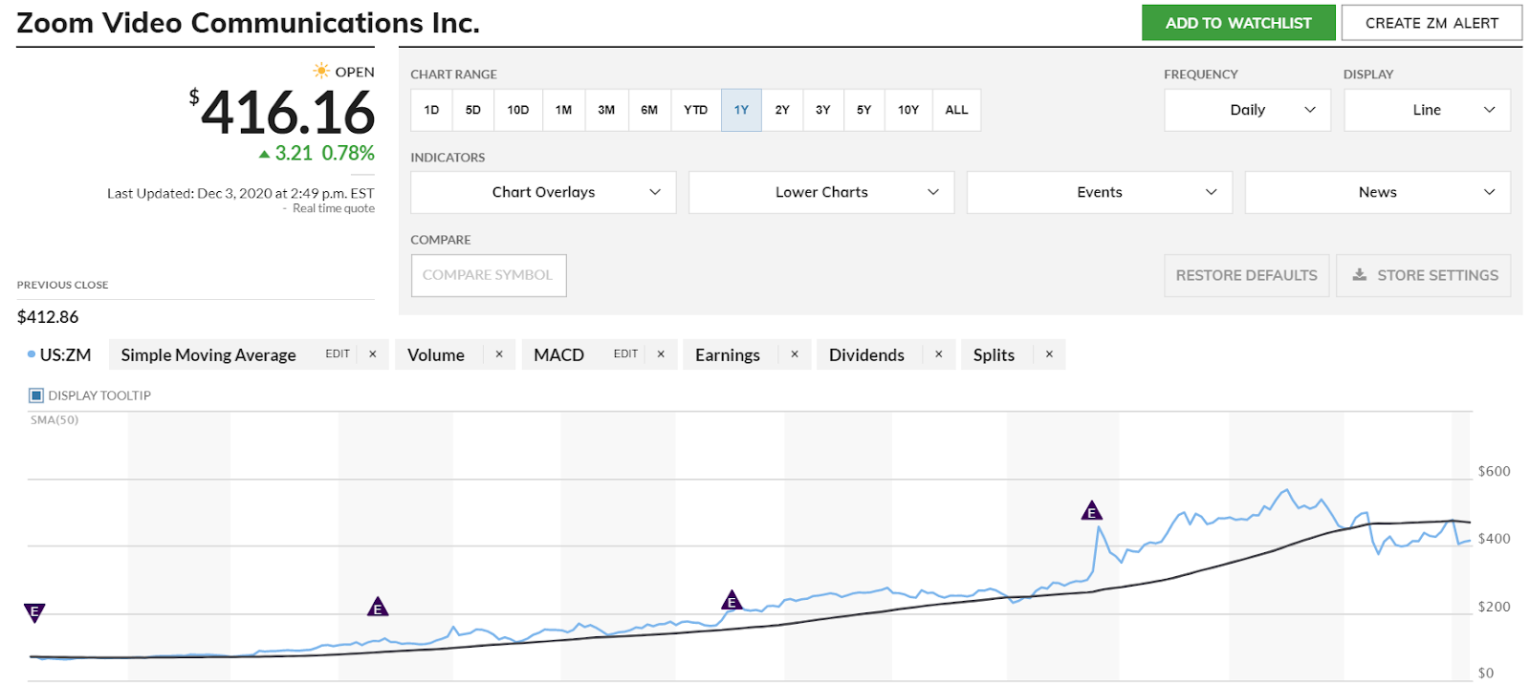
Zoom vs Industry Averages
Unlike other companies the pandemic help zoom separate from the rest of their competitors. Being the preferred meeting option for business meetings, college lectures, or just friend meetups zooms value has increased incredibly.

